Slide 1

Long Term Conditions
Heart Failure Case Study
Alison Clarke
Highly Specialist Physiotherapist
Cardiothoracic Transplantation

Slide 2

Cardiology Ward
Are you the physio on the ward today?
I’m worried about Mr A’s mobility. He has deteriorated over the last week and now he can’t walk to the toilet by himself. He will be medically fit for discharge next week but I’m worried about how he will manage at home.
Do you mind having a look at him?

Slide 3
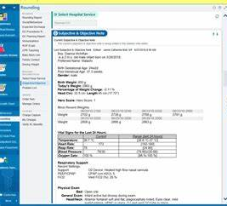
Medical notes
63 year old male
Admitted to hospital 2 weeks ago with acute congestive heart failure
  Shortness of breath
  Reduced mobility
PMH:
  Class III heart failure diagnosed 2 years ago
  T2DM
  GORD

Slide 4
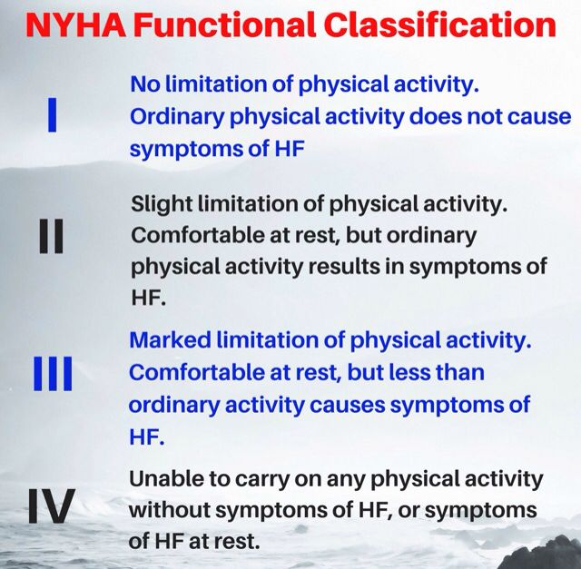

Slide 5
What would you like to ask Mr. A. in your subjective Assessment?

Slide 6
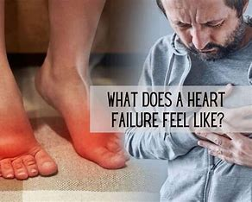
Present condition of Mr. A
Struggling to walk: feels breathless and legs are heavy
Having to sleep with head bed elevated

Slide 7
Social History from Mr. A
Lives with wife
1 flight of stairs with 1 rail on the left ascending
No equipment
Walks unaided indoors
Walks with a walking w/stick longer distances outdoors
Exs tol: 20 mins without stopping

Slide 8
What would you like to include in your objective assessment?

Slide 9
A-E assessment
A: Own
B: S/V on 1lO2 via n/c. SpO2 95%. RR 12
C: HR 90, BP 100/80 (70), T 36.5
D: Alert and talking in bed. GCS 15/15. Able to move all 4 limbs
E: In pyjamas. Nasal cannula, cardiac monitor: Peripheral oedema, especially legs and feet

Slide 10
Is it safe to start getting Mr. A out of bed to start a functional assessment?
What would you like to include in your functional assessment?

Slide 11
Functional Assessment
Lie to SOEOB with difficulty but (I)
Needs AO1 to put slippers on. Can’t bend forward as feeling so breathless
STS (I) slowly, felt dizzy for about 5 seconds
Mobilised approximately 10m with HHAO1 // very breathless
Sat in chair

Slide 12
What is your problem list?

Slide 13
What is your treatment plan?

Slide 14
Goal setting

Slide 15
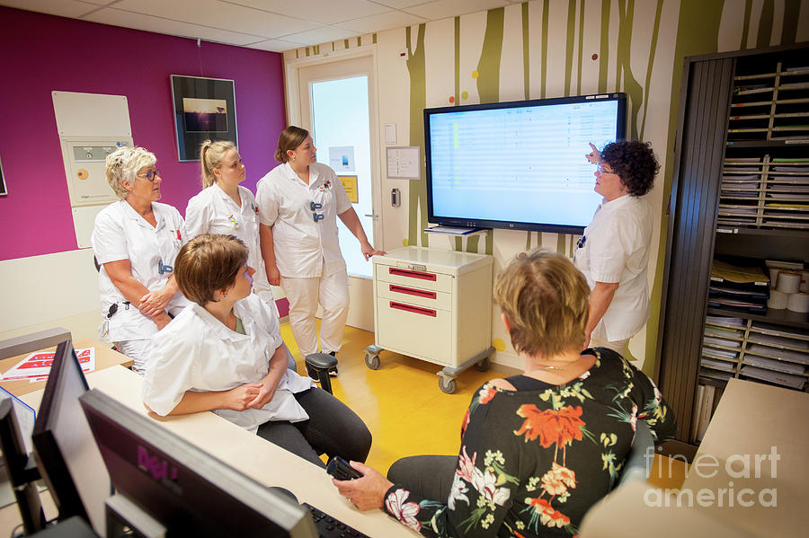
Ward handover the next morning
Physio…..
Did you get a chance to assess Mr. A yesterday?
Do you think he can go home next week?

